Slide 1
World Urban Development Data Wizard of Oz Presentation
Presented By
Kartikey Pradhan
Murugappan Nachiappan

Slide 2
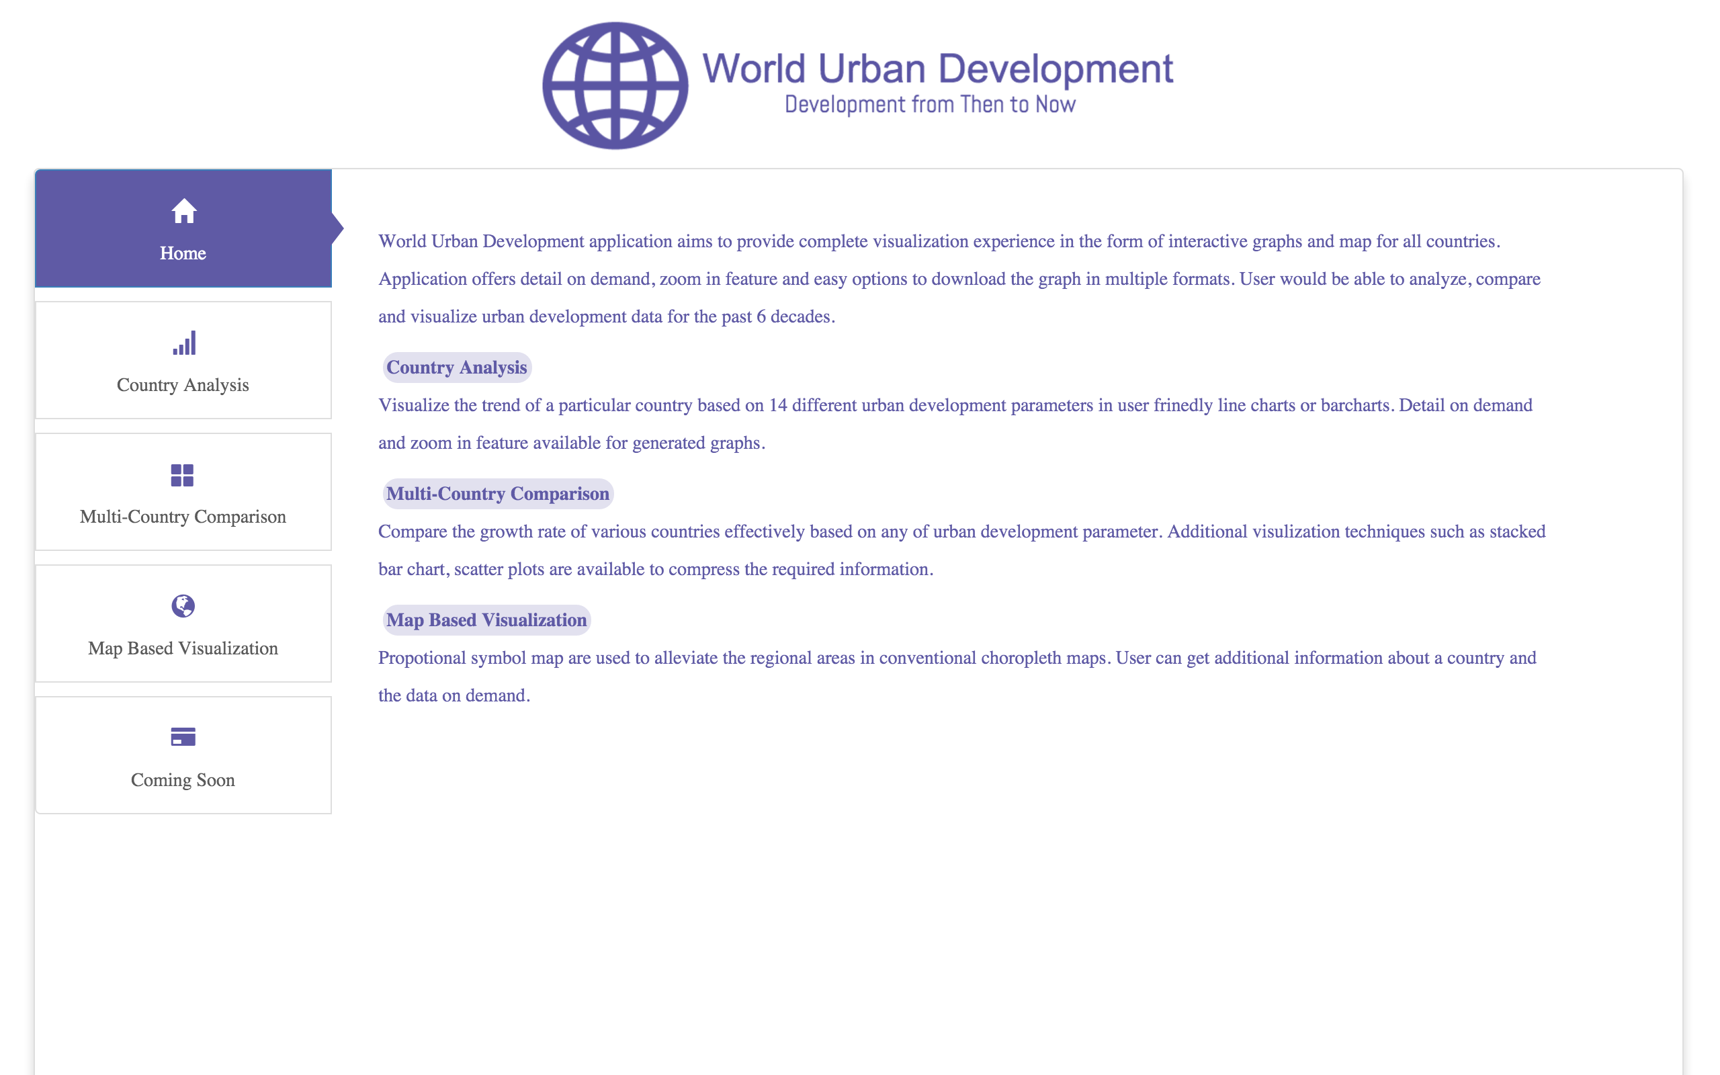
Home Page

Slide 3
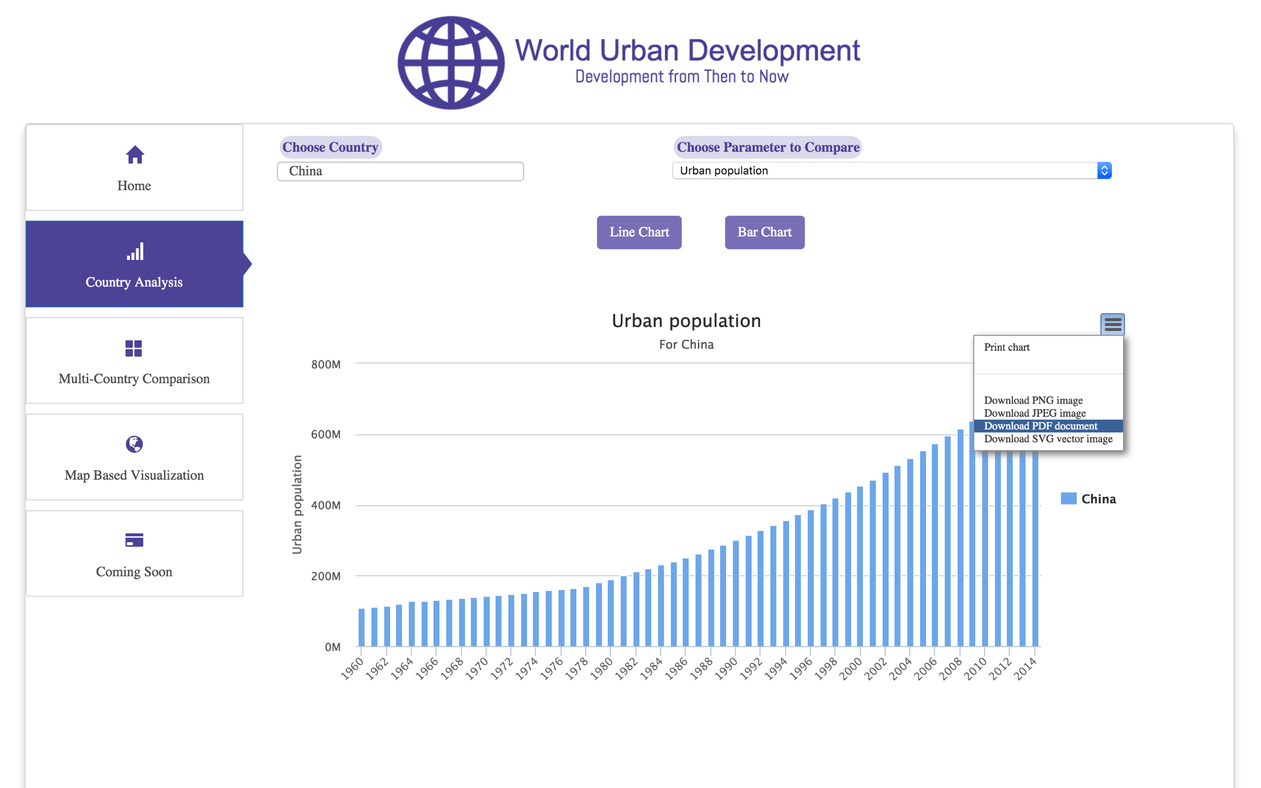
Country Analysis

Slide 4
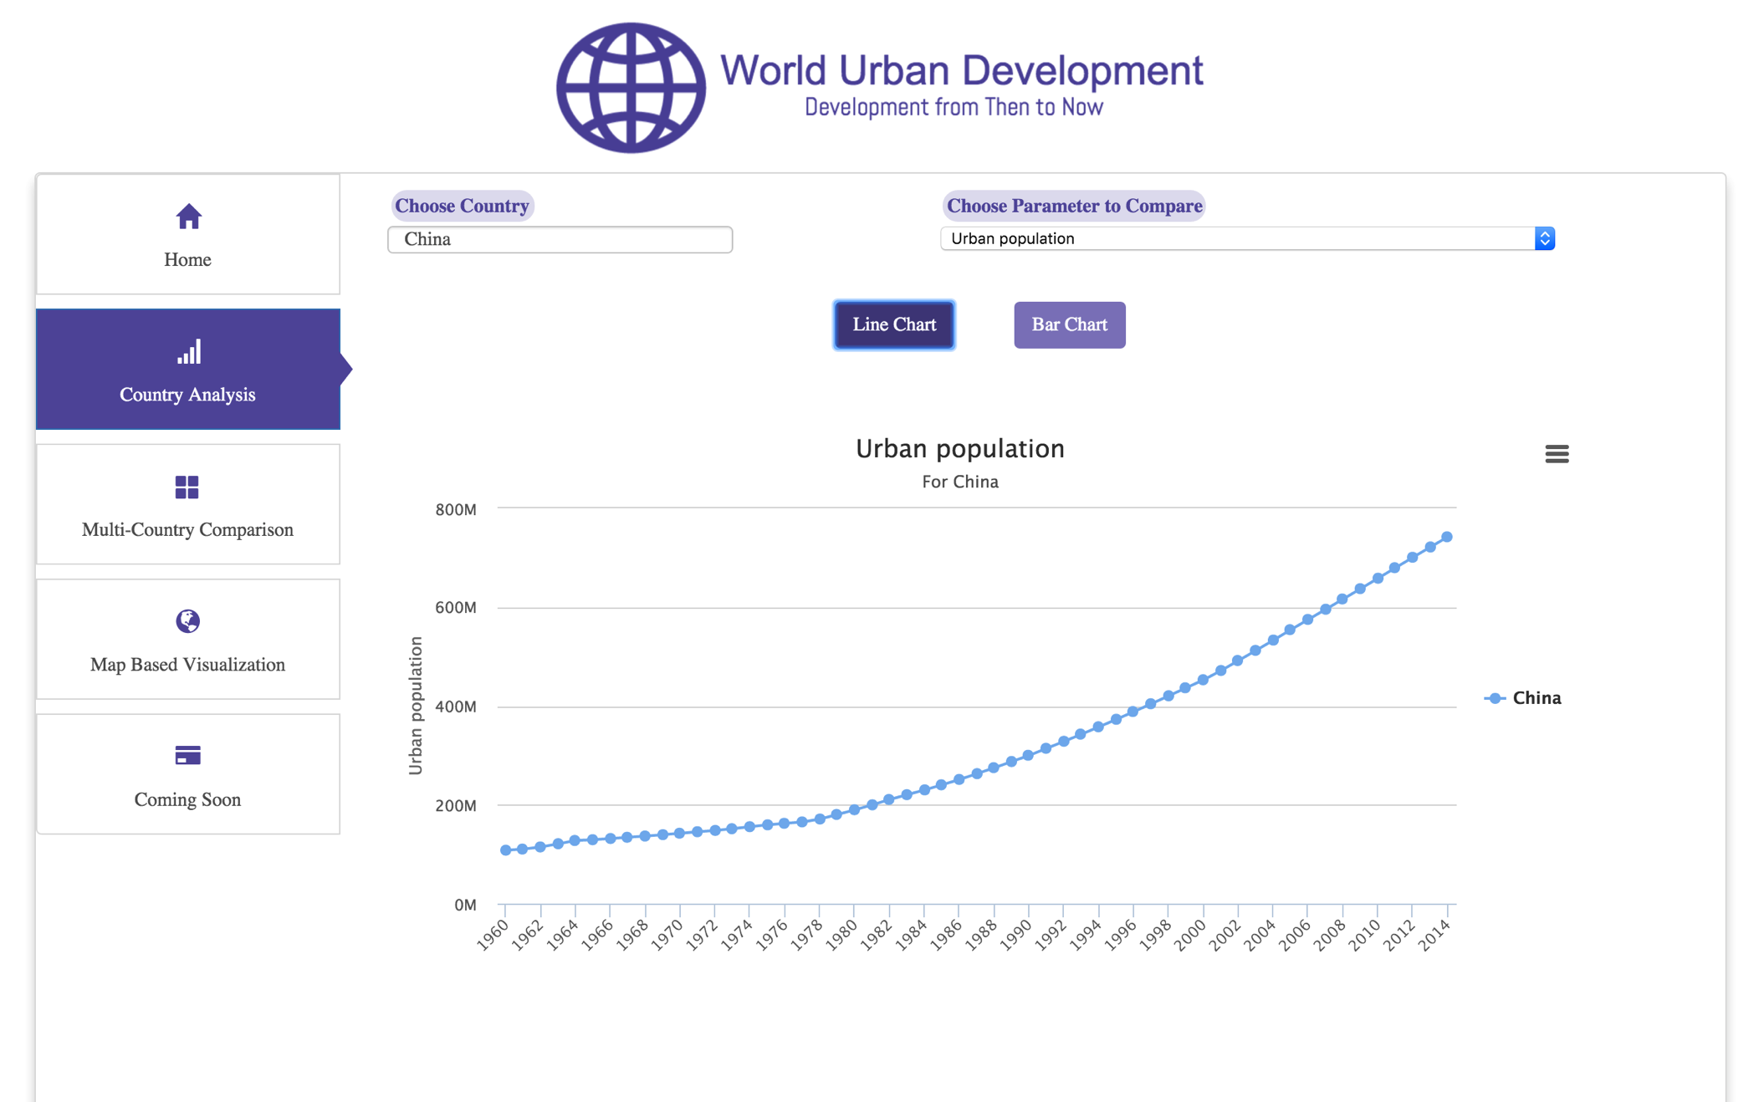
Country Analysis

Slide 5
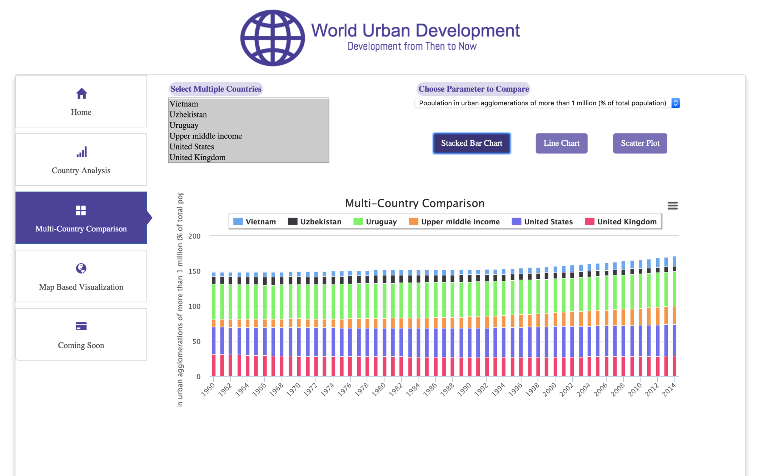
Multi-Country Comparison

